Slide 1
Risk Clinic: Stochasticising a Train Scheduling Model
Hongbo Ye
Risk Institute Thinkover
Inaugural Thinkover at the Institute for Risk and Uncertainty
12:30-2:30 pm, 21 May 2019, Risk Institute Seminar Room, Chadwick Building

Slide 2
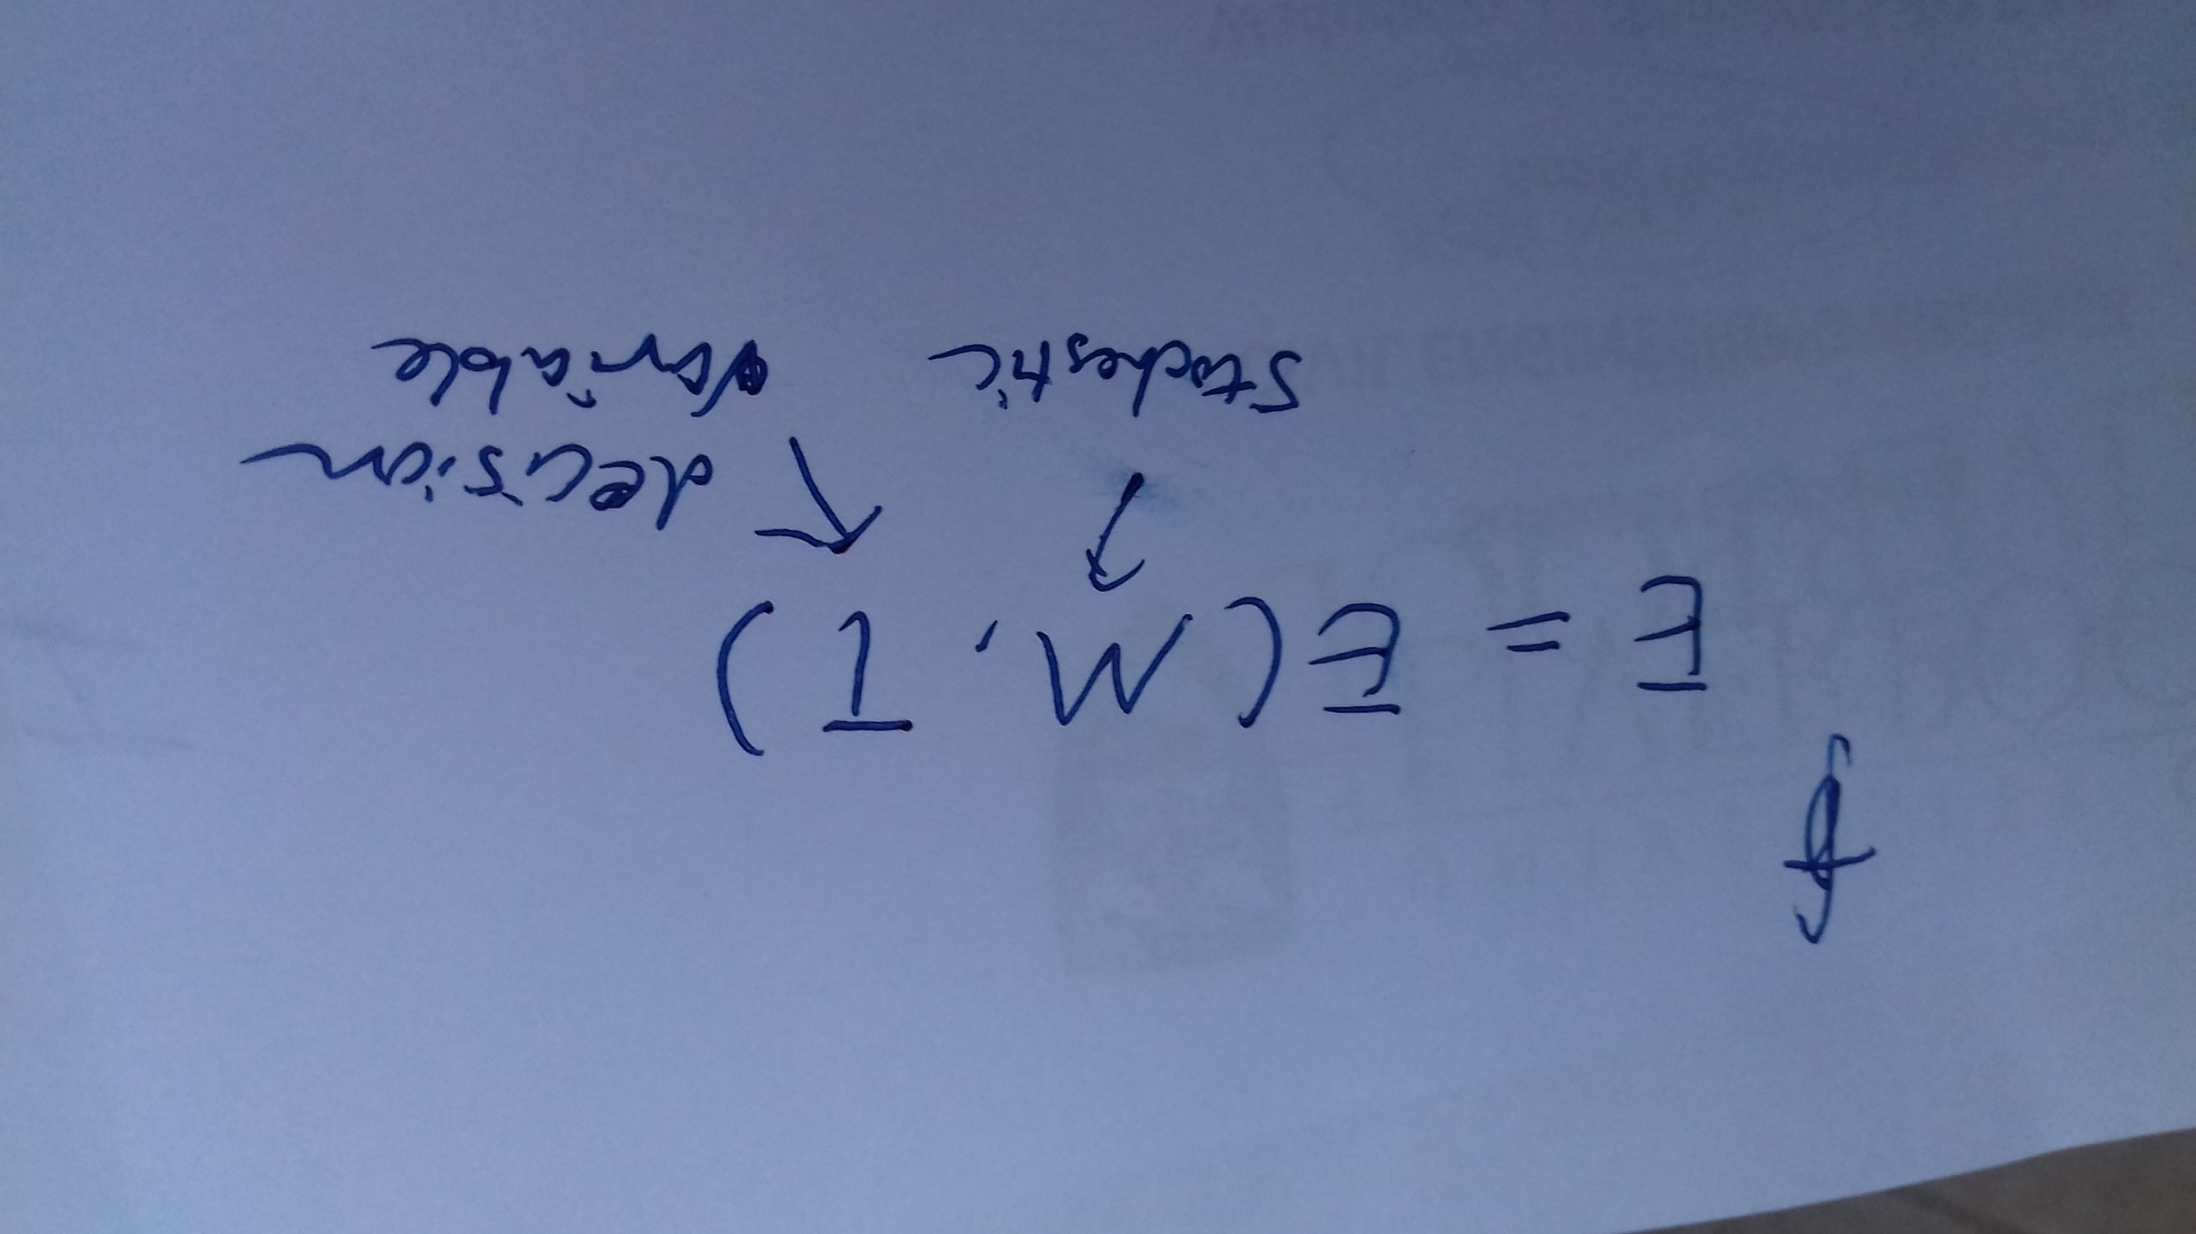

Slide 3
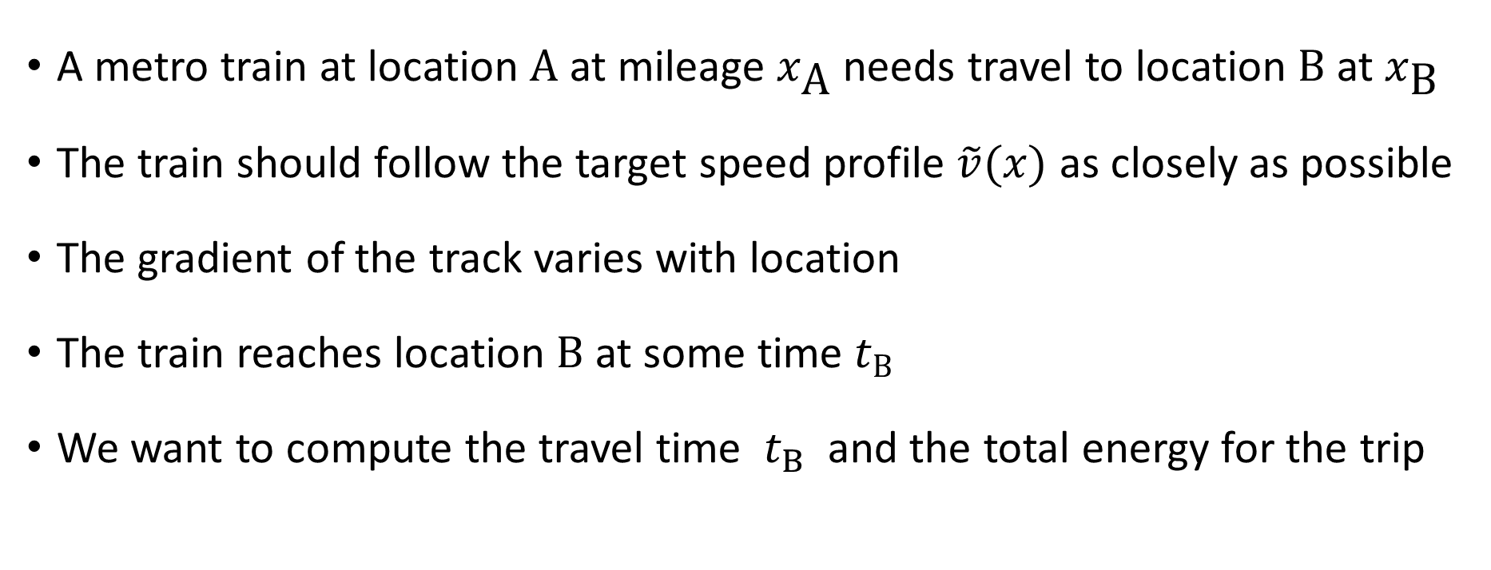
Train scheduling model
A metro train at location A at mileage $x_{\text{A}}$ needs travel to location B at $x_{\text{B}}$
The train should follow the target speed profile $\tilde{v}(x)$ as closely as possible
The gradient of the track varies with location
The train reaches location B at some time $t_{B}$
We want to compute the travel time $t_{B}$ and the total energy for the trip

Slide 4

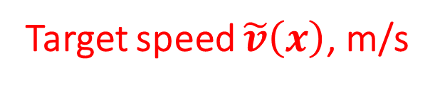

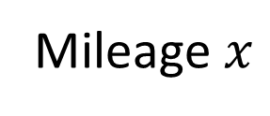
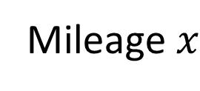



Track and topography of the route
Target speed $\tilde{v}\left(x\right)$, m/s
Gradient $G\left(x\right)$
25
0.01
This is not the speed limit, which is larger
0
0
-0.01
$$x_{A}$$
$$x_{B}$$
$$x_{A}$$
$$x_{B}$$
Mileage $x$
Mileage $x$

Slide 5
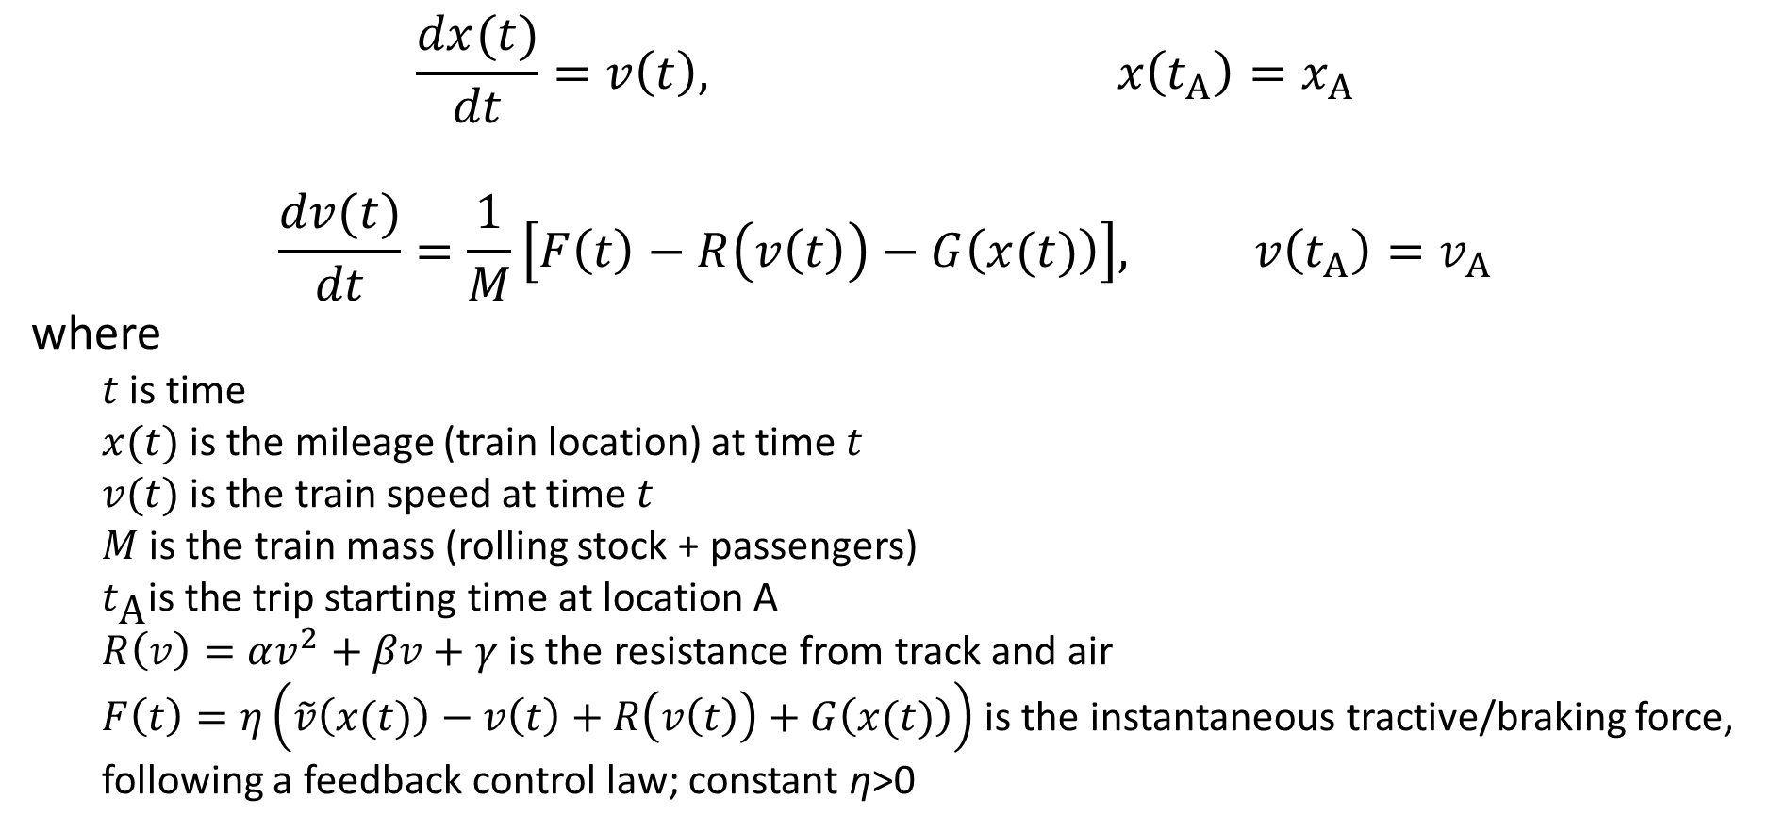
Movement of the train
$$\frac{dx(t)}{dt}=v\left(t\right), x\left(t_{A}\right)=x_{A}$$
$$\frac{dv(t)}{dt}=\frac{1}{M}\left[F\left(t\right)−R\left(v\left(t\right)\right)−G\left(x(t)\right)\right], v\left(t_{A}\right)=v_{A}$$
where
  $t$ is time
  $x(t)$ is the mileage (train location) at time $t$
  $v(t)$ is the train speed at time $t$
  $M$ is the train mass (rolling stock + passengers)
  $t_{\text{A}}$is the trip starting time at location A
  $R\left(v\right)=αv^{2}+βv+γ$ is the resistance from track and air
  $F\left(t\right)=η\left(\tilde{v}\left(x(t)\right)−v\left(t\right)+R\left(v\left(t\right)\right)+G\left(x(t)\right)\right)$ is the instantaneous tractive/braking force, following a feedback control law; constant η>0

Slide 6
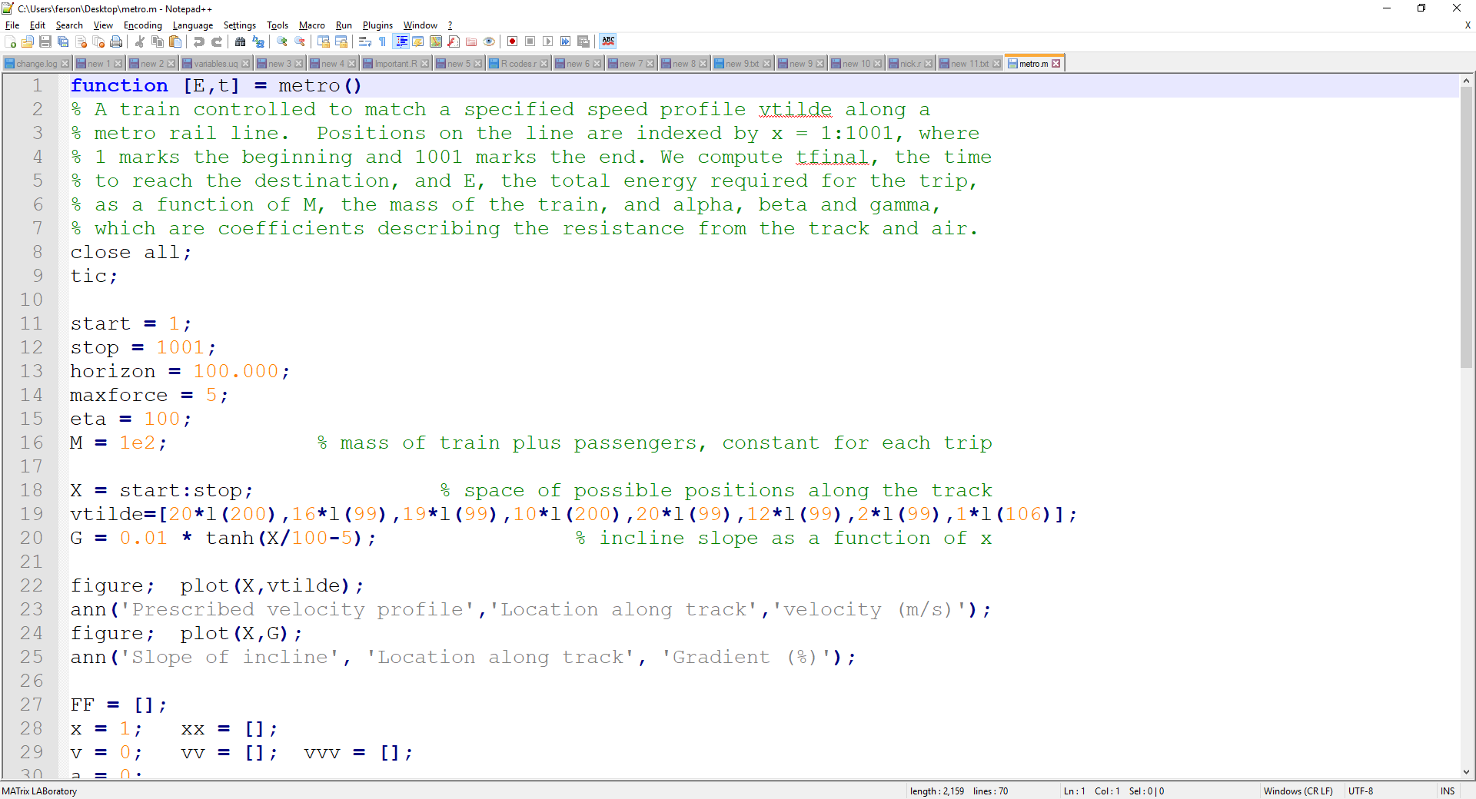
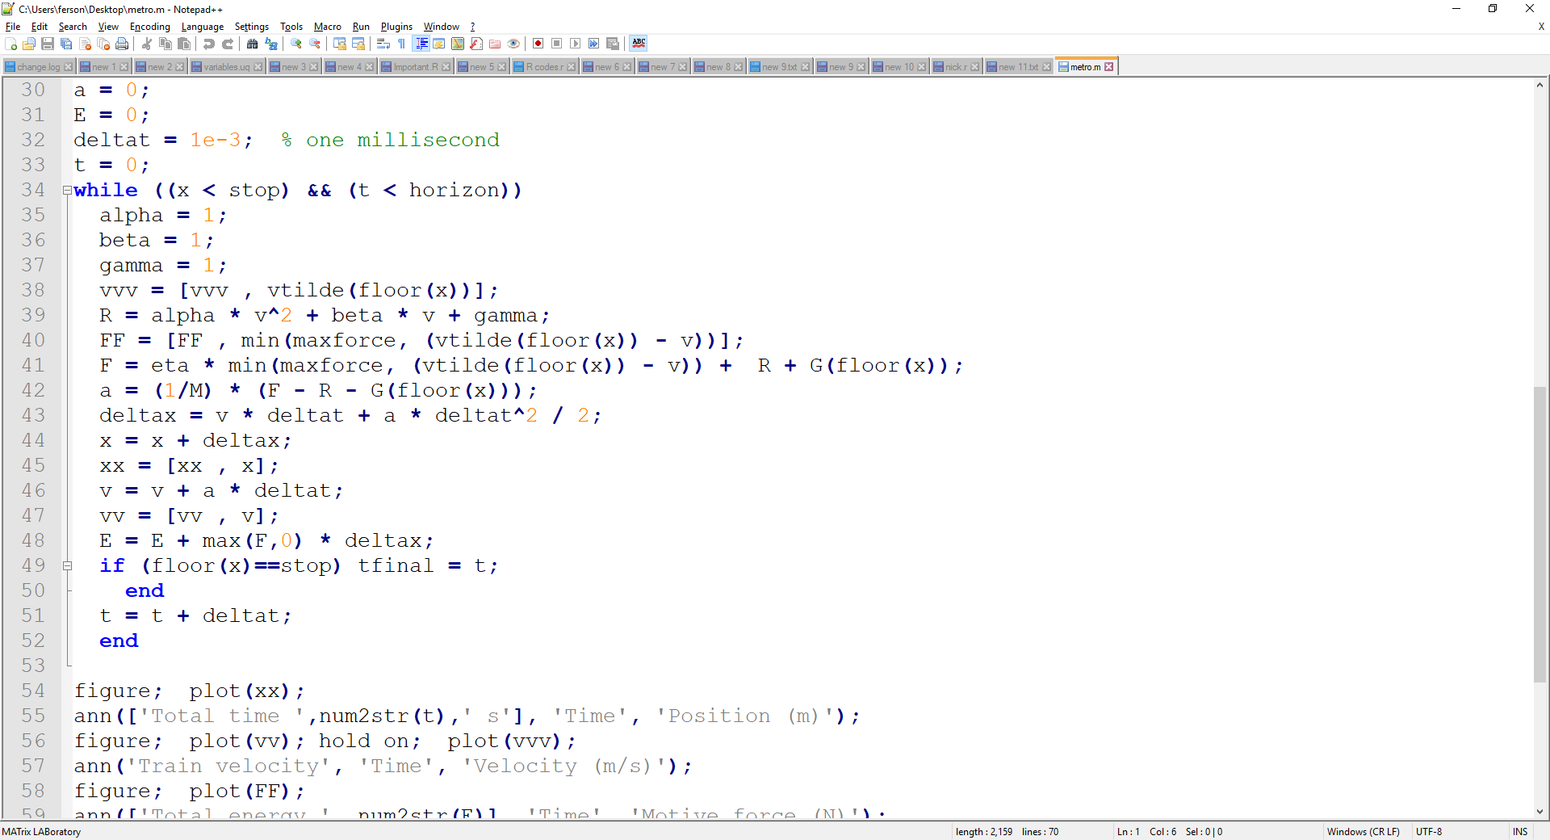
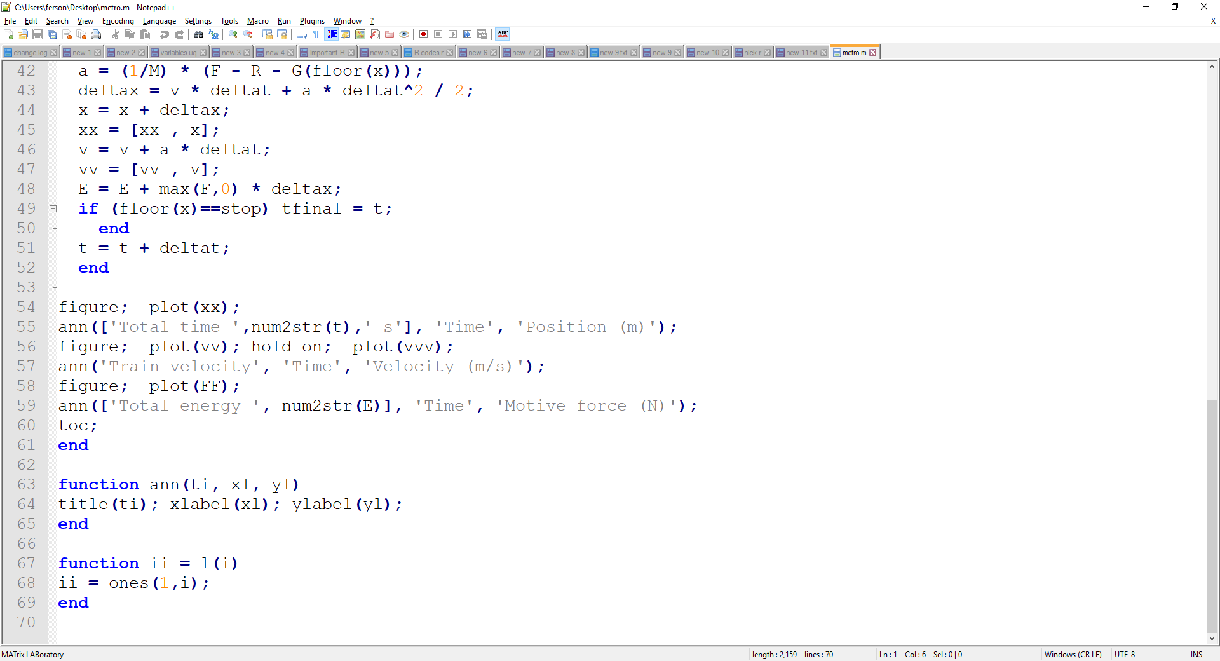
Matlab

Slide 7
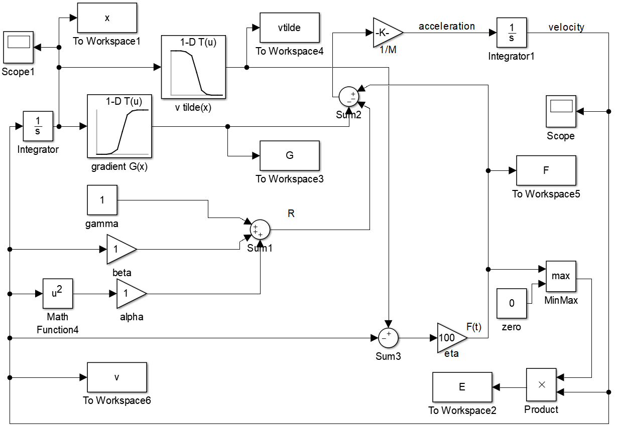
Simulink

Slide 8
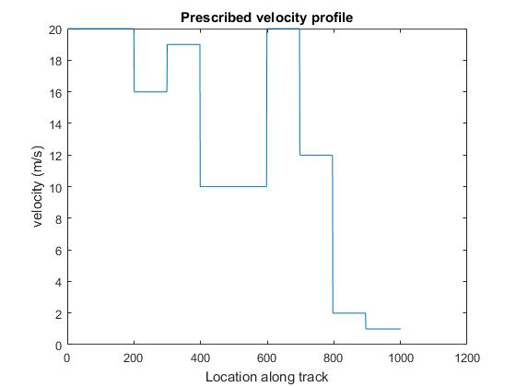
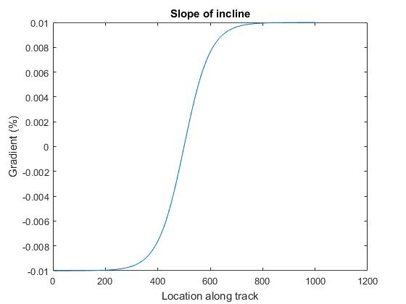
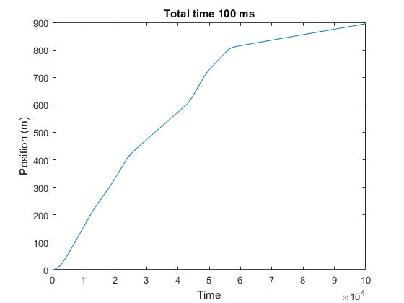

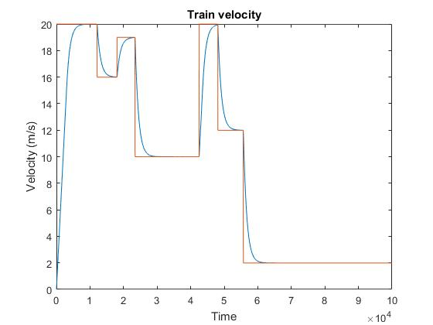
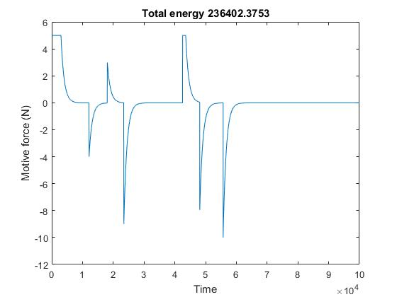
Outputs
function [E,t] = metro()
% A train controlled to match a specified speed profile vtilde along a
% metro rail line. Positions on the line are indexed by x = 1:1001, where
% 1 marks the beginning and 1001 marks the end. We compute tfinal, the time
% to reach the destination, and E, the total energy required for the trip,
% as a function of M, the mass of the train, and alpha, beta and gamma,
% which are coefficients describing the resistance from the track and air.
close all;
tic;
start = 1;
stop = 1001;
horizon = 100.000;
maxforce = 5;
eta = 100;
M = 1e2; % mass of train plus passengers, constant for each trip
X = start:stop; % space of possible positions along the track
vtilde=[20*l(200),16*l(99),19*l(99),10*l(200),20*l(99),12*l(99),2*l(99),1*l(106)];
G = 0.01 * tanh(X/100-5); % incline slope as a function of x
figure; plot(X,vtilde);
ann('Prescribed velocity profile','Location along track','velocity (m/s)');
figure; plot(X,G);
ann('Slope of incline', 'Location along track', 'Gradient (%)');
FF = [];
x = 1; xx = [];
v = 0; vv = []; vvv = [];
a = 0;
E = 0;
deltat = 1e-3; % one millisecond
t = 0;
while ((x < stop) && (t < horizon))
alpha = 1;
beta = 1;
gamma = 1;
vvv = [vvv , vtilde(floor(x))];
R = alpha * v^2 + beta * v + gamma;
FF = [FF , min(maxforce, (vtilde(floor(x)) - v))];
F = eta * min(maxforce, (vtilde(floor(x)) - v)) + R + G(floor(x));
a = (1/M) * (F - R - G(floor(x)));
deltax = v * deltat + a * deltat^2 / 2;
x = x + deltax;
xx = [xx , x];
v = v + a * deltat;
vv = [vv , v];
E = E + max(F,0) * deltax;
if (floor(x)==stop) tfinal = t;
end
t = t + deltat;
end
figure; plot(xx);
ann(['Total time ',num2str(t),' s'], 'Time', 'Position (m)');
figure; plot(vv); hold on; plot(vvv);
ann('Train velocity', 'Time', 'Velocity (m/s)');
figure; plot(FF);
ann(['Total energy ', num2str(E)], 'Time', 'Motive force (N)');
toc;
end
function ann(ti, xl, yl)
title(ti); xlabel(xl); ylabel(yl);
end
function ii = l(i)
ii = ones(1,i);
end

Slide 9
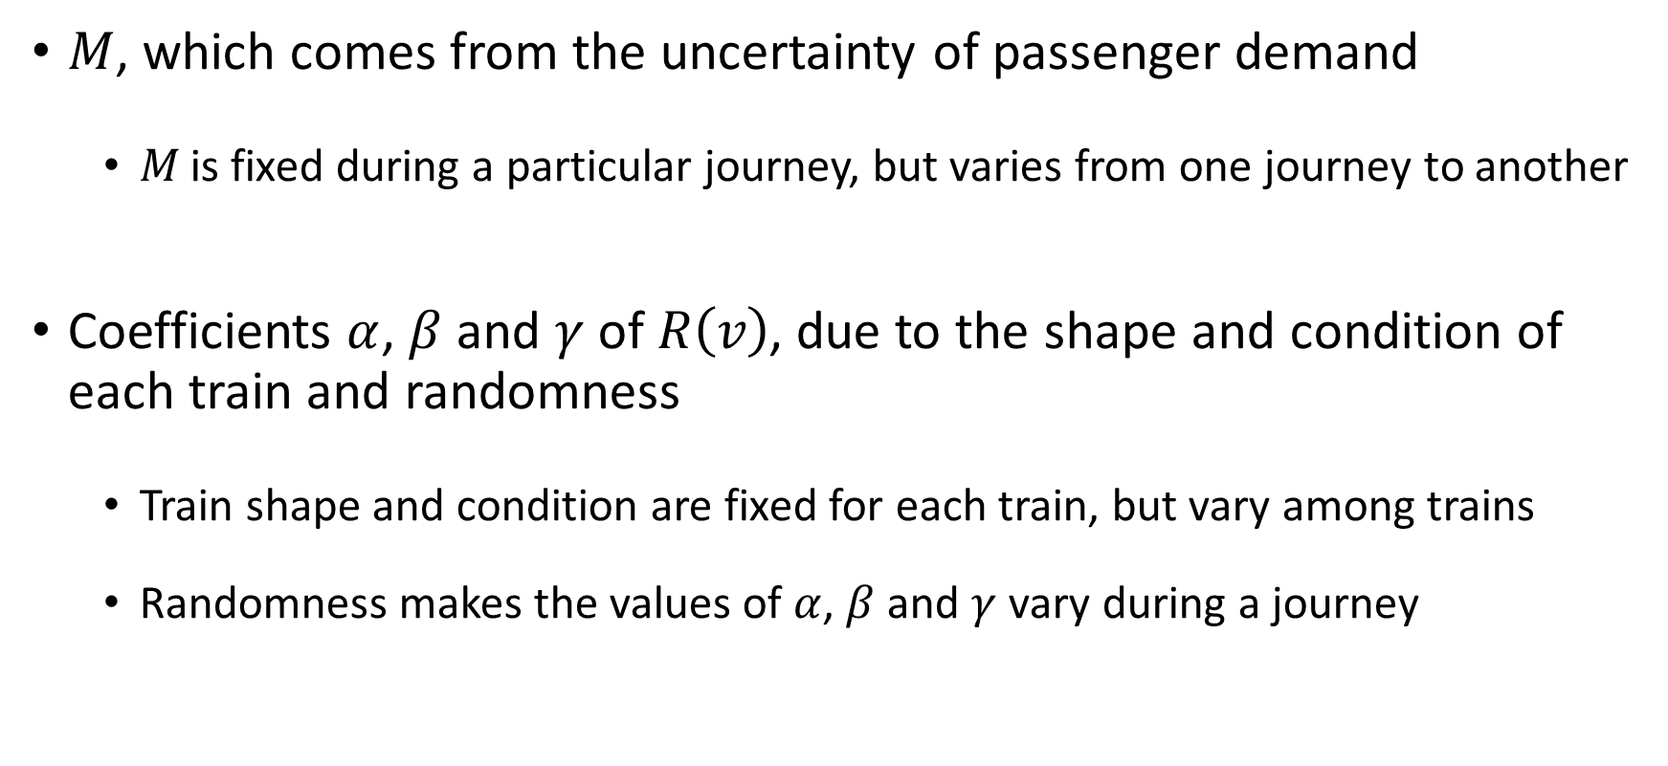
Uncertainty
$M$, which comes from the uncertainty of passenger demand
  $M$ is fixed during a particular journey, but varies from one journey to another
Coefficients $α$, $β$ and $γ$ of $R\left(v\right)$, due to the shape and condition of each train and randomness
  Train shape and condition are fixed for each train, but vary among trains
  Randomness makes the values of $α$, $β$ and $γ$ vary during a journey

Slide 10
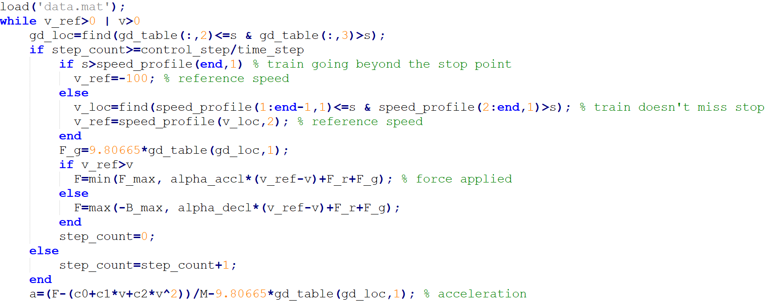
A harder, but more realistic exercise
The original model does not address braking as the train approaches B
Modelling braking requires IF statements and table lookups

Slide 11
Files
metro.m : simple deterministic model without braking
metro0.m : version that made the graphs on these slides
metro.slx : early implementation in Simulink
train.m : deterministic model with braking
slowtrain.m : just the same as train.m but with animation
data.mat : lookup table data needed by train.m

Slide 12
Stochasticising the models

Slide 13
But what about
stochasticity?
…propagating
measurement error
bouquet
…propagating
temporal variability
tangle

Slide 14
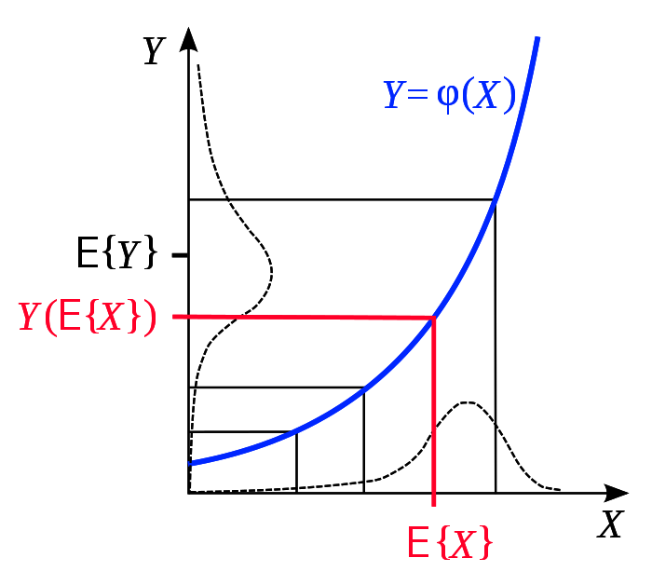
Stochasticisation surprises
Tails are sometimes more important than the means
Different uncertainties accumulate differently
“Optimal” is often very different under noise or incertitude
Nonlinear function of a mean isn’t mean of the function
Bias usually systematic, e.g., Jensen f(EX) ≤ E f(X), for any convex f, i.e., if 0 ≤ f ′′(0)

Slide 15
Bias (incertitude) accumulates
Randomness self-cancels
100
Excess of heads over tails
0
200
400
600
800
1000
-100
Number of coin tosses

Slide 16
Exceedance risk
Output
System response variable
0
Time
t

Slide 17
Risk as a function of the threshold
Probability
Threshold

Slide 18
Multiplicative accumulation over 300 time steps
x(t+1) = x(t) × normal(1.01, sd)
X(0) = 2000
sd ∈ {0, 0.001, 0.005, 0.01, 0.02, 0.03, 0.04, 0.05, 0.06}
1000 replicates

Slide 19
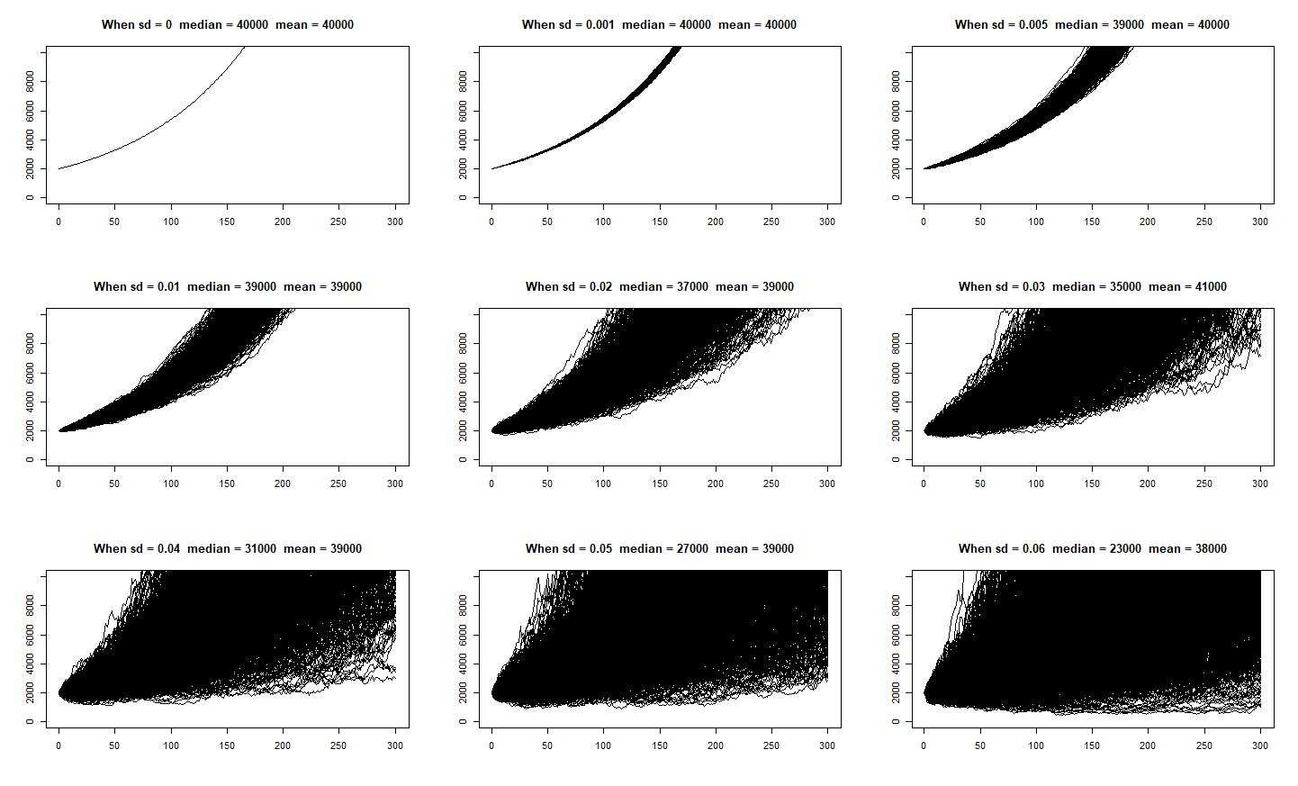
time = 1:300
start = 2000
many = 1050
Max = 10000
rm = 1.01
vv = c(0, 0.01, 0.05, 0.1, 0.2, 0.3, 0.4, 0.5, 0.6)/10
par(mfrow=c(3,3))
pl = function(col, t, x, y) {for (i in 1:length(x)) lines(c(t-1,t), c(x[[i]],y[[i]]),col=col); return(y)}
for (v in vv) {
plot(NULL, xlim=range(time), ylim=c(0,Max), xlab='', ylab='')
x4 = rnorm(many,start,v)
for (t in time) x4 = pl('black',t,x4,x4 * rnorm(many,rm,v))
title(paste('When sd =',v,' median =',signif(median(x4),2),' mean =',signif(mean(x4),2)))
}

Slide 20
0
10^5

Slide 21
Problem, form, approach and methods
Problem
Forward propagation
Backcalculation
Reliability
Optimisation or decision
Sensitivity analysis
Validation
Estimation or calibration
Compliance checking
Plan empirical effort
Mathematical form
Logic or fault tree
Arithmetic
Finite-element model
Differential equations

Slide 22
Approaches to forward uncertainty propagation
Brute-force what-if analysis (sensitivity analysis)
Interval analysis
First-order approximations
Monte Carlo simulation
Fuzzy arithmetic
Probability bounds analysis (p-boxes)
Credal sets
Hybrid numbers

Slide 23
Methods for picking distributions
Make stuff up Posit plausible assumptions
Method of matching moments
Maximum likelihood
Maximum entropy; expert elicitation
Bayesian inference
Confidence boxes

Slide 24
Don’t forget the dependence assumptions
Are all the variables really independent of one another?
Do you have correlations and scatterplots?
Can you model the dependence?
Zero correlation doesn’t imply independence
Small correlation doesn’t mean you can ignore dependence
Not knowing dependence doesn’t justify assuming independence

Slide 25
End

Slide 26
Checklist
Ask a question that’s both relevant and specific.
Analyze uncertainty.
Admit what you don’t know.
Account for the different kinds of uncertainty.
Avoid making assumptions.
Audit the analysis.
Answer the question and address the audience.

Slide 27
Analyze uncertainty.
You can always do an uncertainty analysis.
  Too little empirical information is not an argument to skip the uncertainty analysis.
  Poor data may require using non-probabilistic methods.
Use bounding rather than biasing numbers to account for incertitude.
  Biasing cannot simultaneously reveal how bad and how good the outcome can be.
Avoid entanglement in purely mathematical problems.
  Real risk assessments should not involve distributions with infinite ranges.
  Don’t worry about results that hinge on a set being “closed” or “open”.

Slide 28
Admit what you don’t know.
Characterize the uncertainty for every input parameter.
  Respect and use all available data, without believing their hype.
  Do not assume the observed range is the possible range.
  Do not assume a precise distribution without sufficient empirical or theoretical justification.
  Don’t set “unimportant” variables to constants; but you can characterize them coarsely.
Characterize the interaction or dependence among all the parameters.
  Do not assume independence among variables without theoretical justification
  Do not assume variables are merely correlated without reasonable justification.
  Take account of any impossibility of certain combinations.
  If possible, insist on empirical confirmation.
Characterize the uncertainty about the model itself, including its structural form.
  Express model uncertainty as parametric uncertainty when possible.
  Use prediction intervals rather than confidence intervals from regressions.

Slide 29
Account for the different kinds of uncertainty.
Represent incertitude with bounding methods.
  Incertitude includes plus-and-minus ranges and other forms of measurement uncertainty.
  Incertitude includes data censoring and uncertainty arising from laboratory non-detects.
  Incertitude usually includes doubt about model structure and other kinds of scientific ignorance.
Model variability using probability methods (i.e., mixture models).
  Variability usually includes spatial variation and temporal fluctuation.
  Variability usually includes genetic differences and heterogeneity among individuals.
  Variability usually includes inconsistencies in fabrication and sometimes material nonuniformity.
  Variability usually includes any of the consequences of natural stochasticity.
Treat incertitude and variability separately, and differently.
  The uncertainty in inputs should not confuse the two kinds of uncertainty.
  Treating incertitude as variability is much worse than treating variability as incertitude.
  The convolutions of the risk model should preserve the two kinds of uncertainty in the outputs.

Slide 30
Avoid making assumptions.
  The more assumptions you make, the less credible your conclusions are.
Just because a model is simple doesn’t mean it’s not making strong assumptions.
  Linearity is a very strong assumption.
  Independence is a very strong assumption.
  Lognormality, normality, uniformity and triangularity are very strong assumptions.
Relax strong assumptions that are not supported by evidence or argument.
  Non-parametric and distribution-free techniques avoid making assumptions.
  Bounding and enveloping avoid making assumptions.
  Fréchet inequalities and Fréchet bounds avoid making assumptions about dependence
  What-if scenarios avoid making assumptions about models.
Discharge untenable assumptions.
  Sensitivity analyses can be used to mollify an assessment.
  Don’t average together incompatible models or use Bayesian model averaging.

Slide 31
Audit the analysis.
Check the correctness of the structure of the model.
  Does the model obey the rules of dimensional soundness and do the units of parameters conform?
  Is there a population or an ensemble explicitly specified for every distribution?
  Are the ensembles conformant among combined distributions?
    For instance, is spatial variation never confused or combined with temporal variation?
  Are there no repeated uncertain parameters that would fallaciously inflate uncertainty?
  Are there no multiple instantiations of probability distributions that underestimate uncertainty?
  Are you dividing by or logging distributions that can take zero as a value?
  Do the moments specifying each distribution satisfy the positive semi-definiteness condition?
  Do the distributions obey other moment-range constraints (e.g., min ≤ max; variance ≤ range²/4)?
  Is the matrix of correlation coefficients positive semi-definite?
  Do correlations conform with functional relationships (e.g., if C=A+B, C isn’t independent of A)?
  Does the structure of the model make sense and conform with scientific knowledge?
    Does it respect engineering principles? Does a food web model have a topology lacking intervals sensu Cohen?
  Does the support of each uncertain number jibe with the theoretical range of its parameter?
Check the faithfulness of the model’s implementation.
  Check the range of the outputs against a range analysis of the inputs.
  Check the mean and variance of the outputs against a moments analysis of the inputs.
  Was the random seed randomized? Does another value yield qualitatively similar results?
  Are range checks satisfied?

Slide 32
Answer the question and address the audience.
Make the analysis as transparent as possible to reviewers.
  Specify the intention of the analysis.
  Spell out all assumptions and indicate their likely qualitative influence on the results.
  Explicity list all variables with their units and specify the uncertain numbers used to model them.
  Recount how the correlations and dependencies among variables were modeled.
  Explicitly state the model used to combine them, giving pseudocode or actual code where useful.
  Say what propagation approach and ancillary methods were used.
  Describe checks and sensitivity analyses employed.
  Express answers (whether distributions, bounds or bounds on distributions) graphically.
Answer the “so what?” questions.
  Speak to the specific concerns of the manager or the public.
  Explain the import of the results obtained.
  Quantitatively characterize the robustness of the conclusions.
Admit what you didn’t know.
  Although such honesty can sometimes engender mistrust, it is the only sustainable approach.
  Always ask the audience for help and avoid suggesting you know best.

